Slide 1
Version Control
Sarower Ahmmed

Slide 2
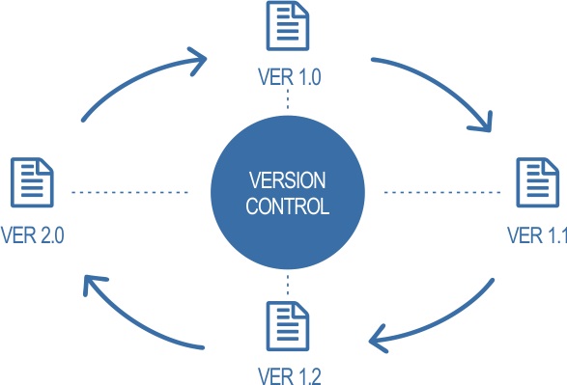

Slide 3
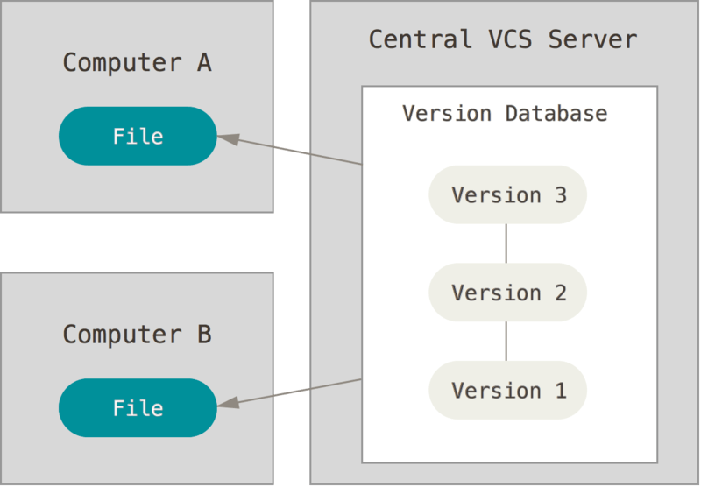

Slide 4


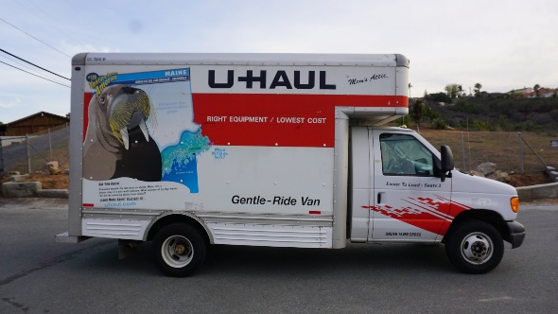
Home
Transport
Storage

Slide 5



Home
Transport
Storage

Slide 6
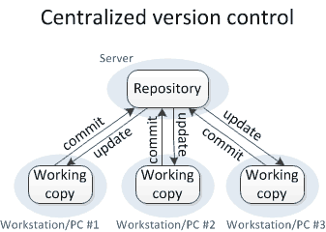

Slide 7



Popular version control in market

Slide 8
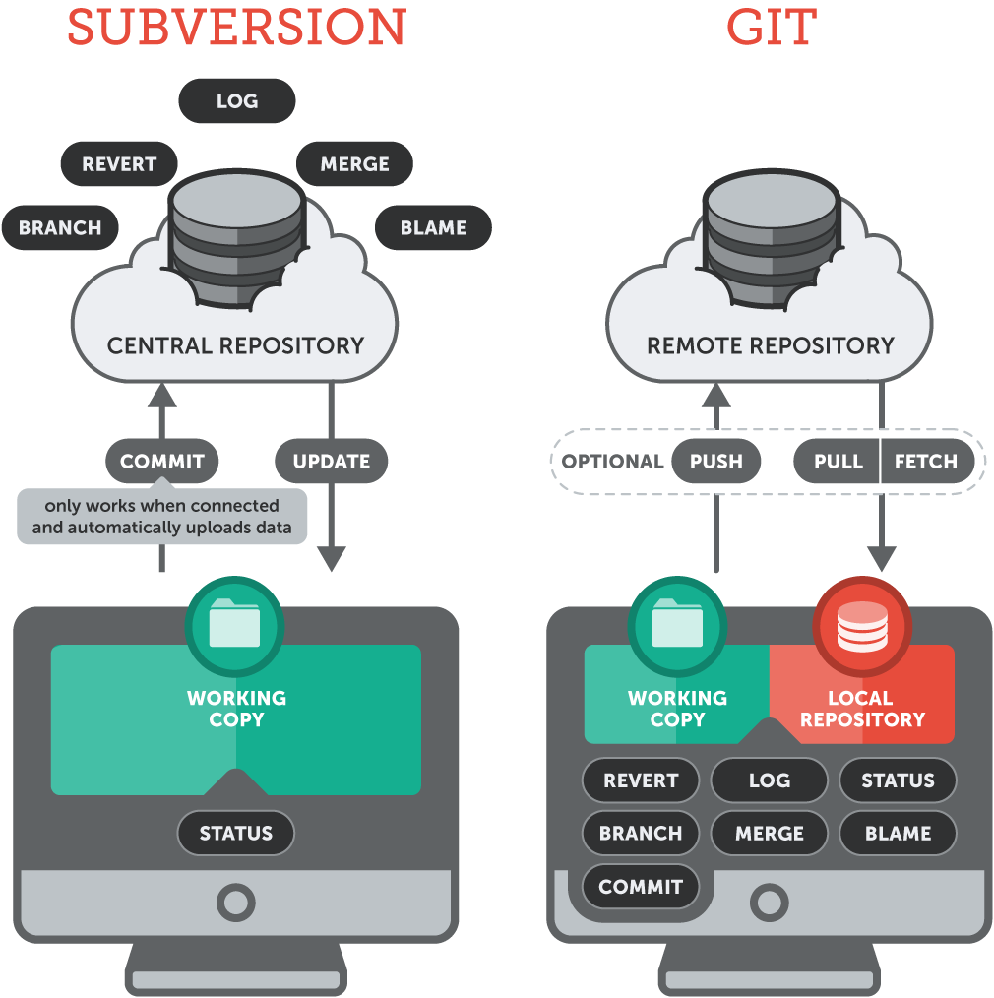

Slide 9
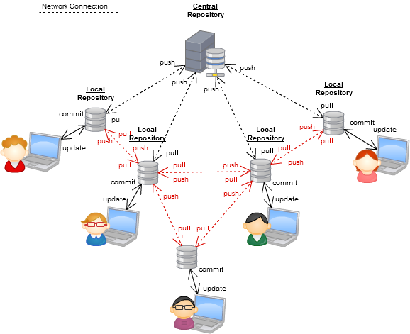

Slide 10
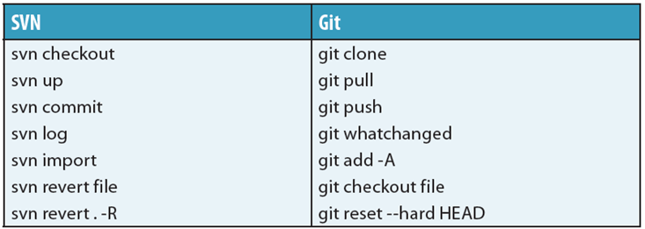

Slide 11
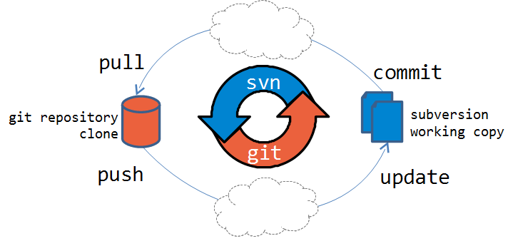

Slide 12
How to tell interview
Need github account
Create new repo >>master/branch
Create new file or upload file
COMMIT it (save)
We can git push or pull
We can do it from github account directly or git bash or Git desktop

Slide 13
How to setup Git for Eclipse
Go to https://github.com/ and sign in
User Name: studentttech@gmail.com
Pass: ttjob123
Click Clone or download> copy URL and paste it in URI

Slide 14
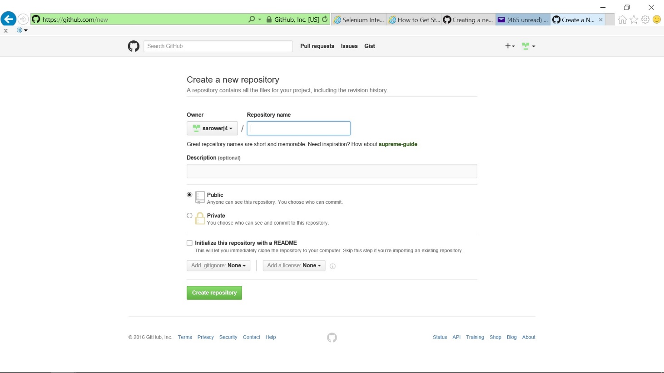

Slide 15
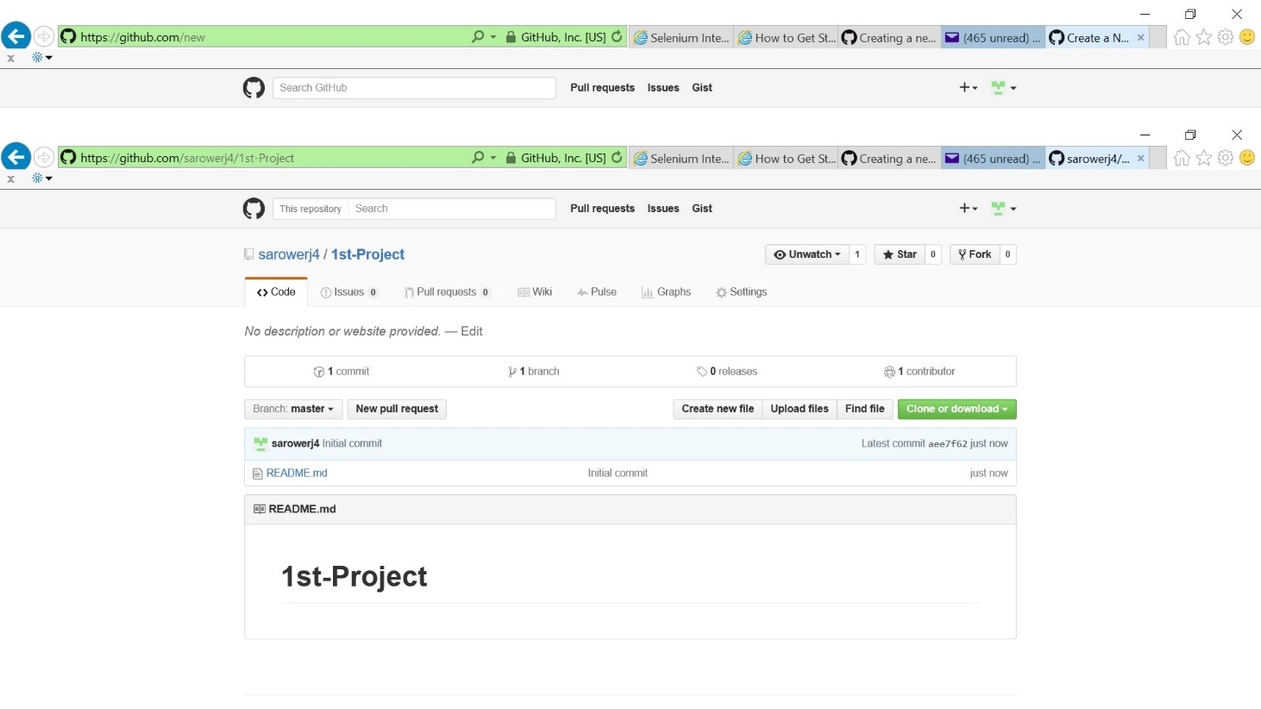

Slide 16
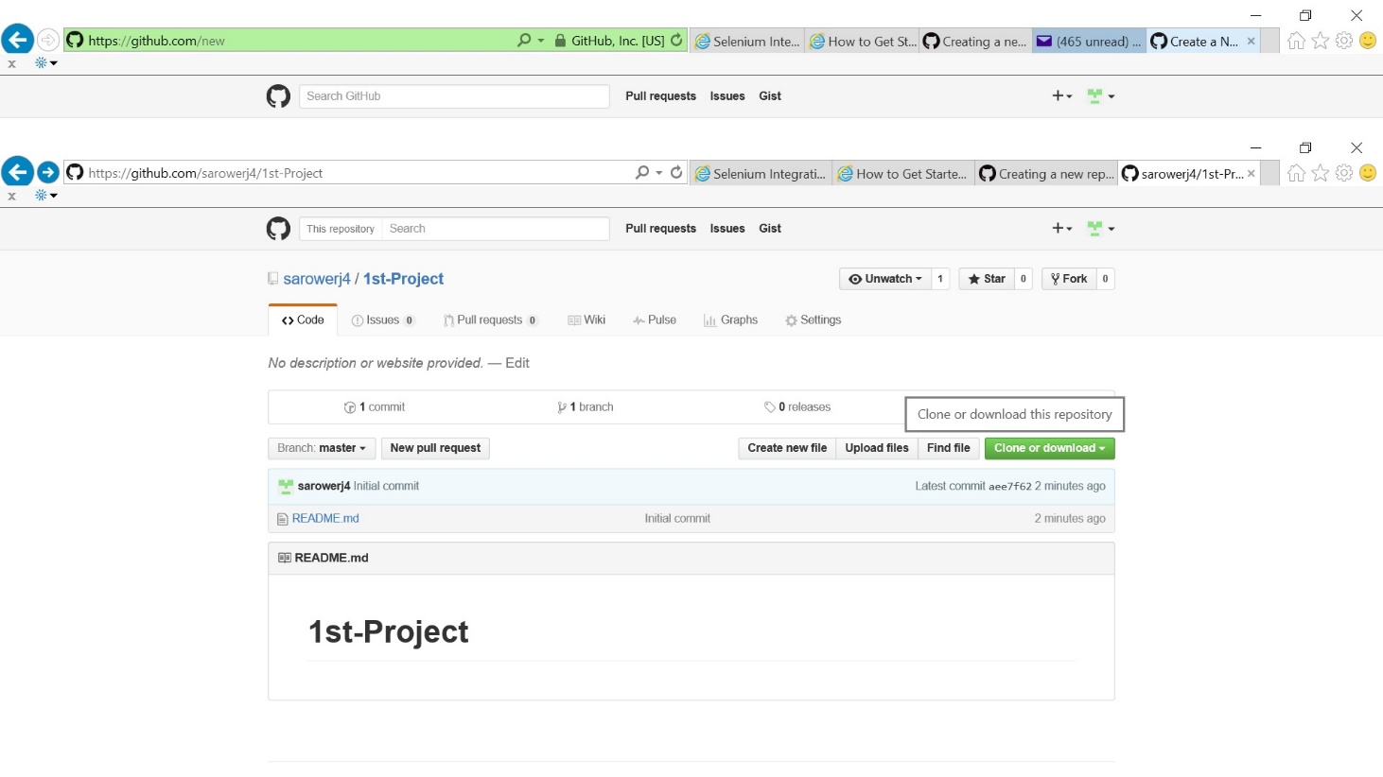
Go to 1st project: click clone and copy HTTP

Slide 17
Add new file from direct Github ot git CMD
Git bash cmd:
Git init
Git add.
Git commint – m “First commit”
Git remote add origin URL
Gut remote – v
Git push origin master

Slide 18
GitHub & Eclipse Setup Video
https://www.youtube.com/watch?v=r5C6yXNaSGo

Slide 19
THANKS

